Slide 1
KLEENE’S THEOREM
225 Automata Theory
Ege University
Department of Computer Engineering
Yrd. Doç. Dr. R. Cenk Erdur, 2010

Slide 2
Kleene’s Theorem
Any language that can be defined by
  “Regular Expression (R.E.)”, or
  “Finite Automation (F.A.)”, or
  “Transition Graph (T.G.)”
  can be defined by all three methods.
  This theorem is the most important and fundamental
  result in the theory of finite automata.
Yrd. Doç. Dr. R. Cenk Erdur, 2010

Slide 3
How can we prove Kleene’s theorem?
  Three sections of our proof will be:
    Part-I: Every language that can be defined by a F.A. can also be defined by a T.G.
    Part-II: Every language that can be defined by a T.G. can also be defined by a R.E.
    Part-III: Every language that can be defined by a R.E. can also be defined by a F.A.
    When we have proven these three parts, we will have
    finished the proof of Kleene’s theorem.
Yrd. Doç. Dr. R. Cenk Erdur, 2010

Slide 4
Proof of Part-I
If you read the F.A. and T.G. definitions again, you can see that every finite automation is itself already a transition graph (T.G.). Therefore, any language that has been defined by a finite automation has already been defined by a transition graph. This concludes the proof of part-I.
Yrd. Doç. Dr. R. Cenk Erdur, 2010

Slide 5
Proof of Part-II
The proof of this part will be by a constructive algorithm. This means that we present a procedure that starts out with a T.G. and ends up with a R.E. that defines the same language.
  The procedure is explained in the following slides…
Yrd. Doç. Dr. R. Cenk Erdur, 2010

Slide 6
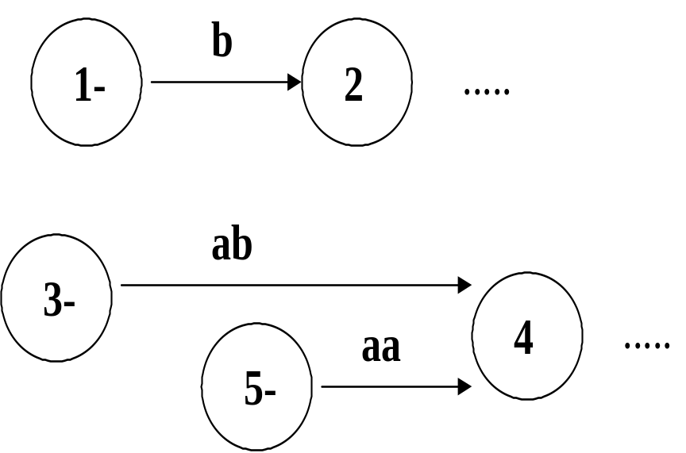
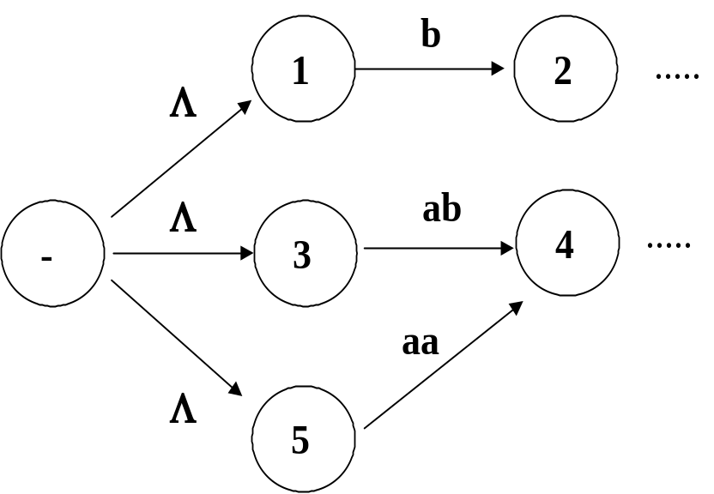
Proof of Part-II
If the T.G. has many start states, then we have to simplify the T.G. so that it has only one start state:
:
:
Yrd. Doç. Dr. R. Cenk Erdur, 2010

Slide 7
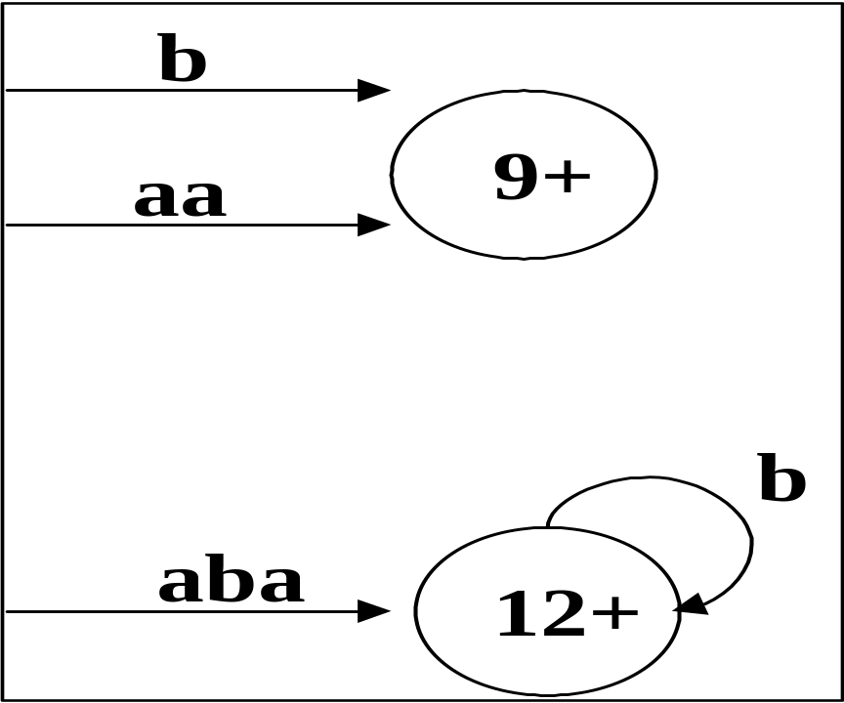
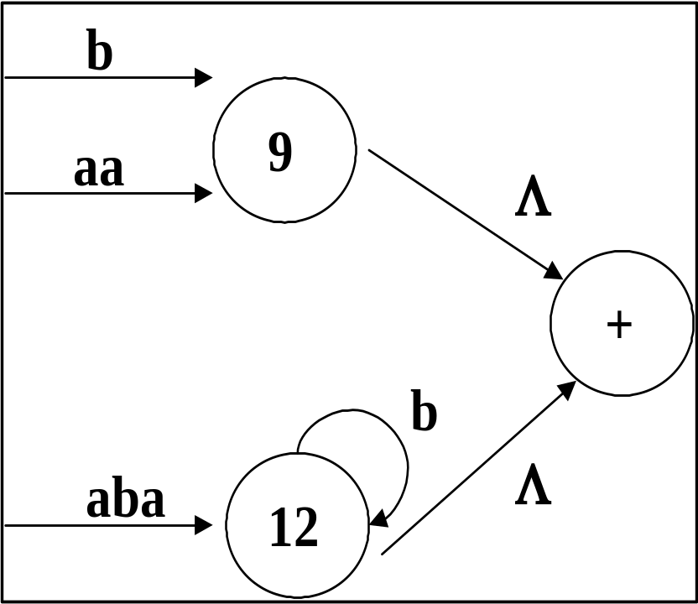
Proof of Part-II
The T.G. has to be modified so that it has only one final state:
Yrd. Doç. Dr. R. Cenk Erdur, 2010

Slide 8
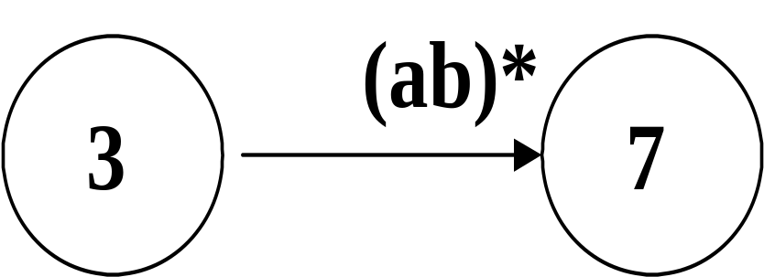
Proof of Part-II
Change the T.G. to a form that allows to write R.E.’s as the labels on the edges:
Yrd. Doç. Dr. R. Cenk Erdur, 2010

Slide 9
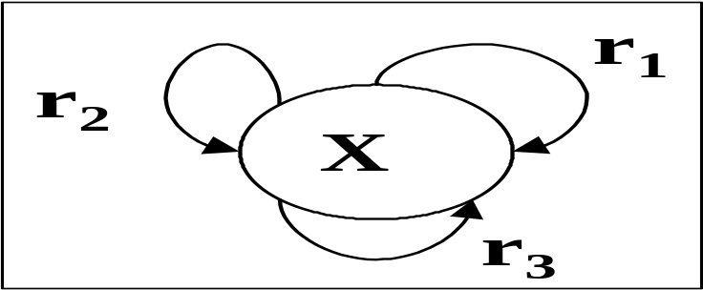
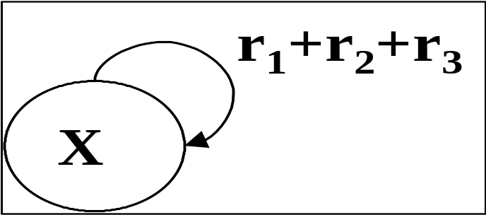
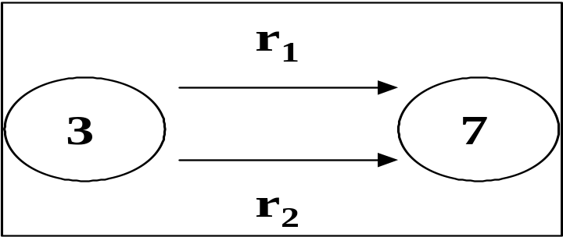
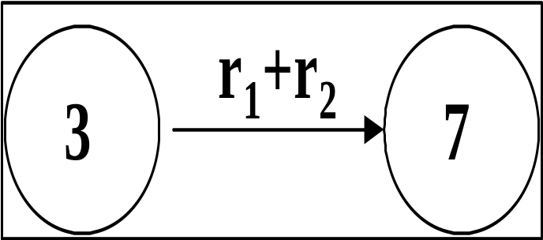
Proof of Part-II
In the T.G. model, we can replace several loops in a state by one loop whose label is formed by summing the R.E.’s. Similarly, several edges from one state to another can be replaced by a single edge whose label is formed by summing the R.E.’s:
Yrd. Doç. Dr. R. Cenk Erdur, 2010

Slide 10
Proof of Part-II
Apply “By Pass and State Elimination Operation” on the T.G, as shown in the next slide.
Yrd. Doç. Dr. R. Cenk Erdur, 2010

Slide 11
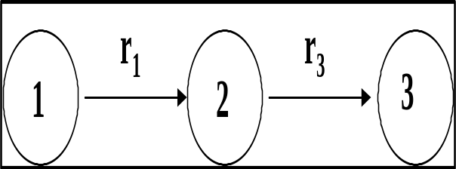
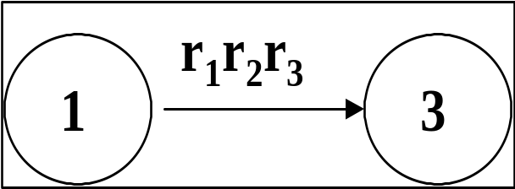
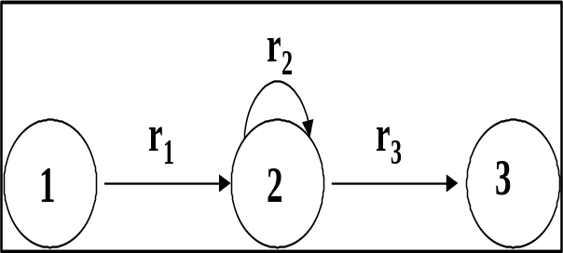
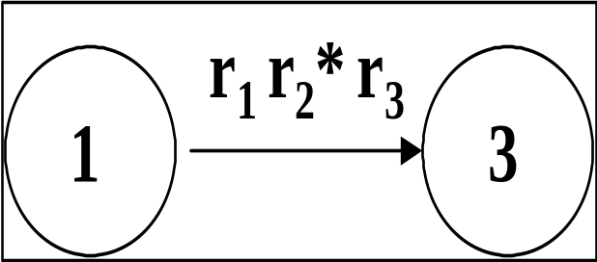
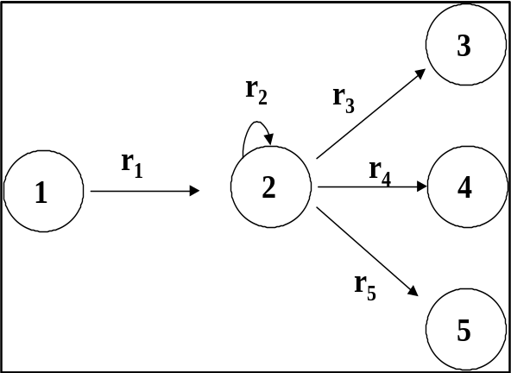
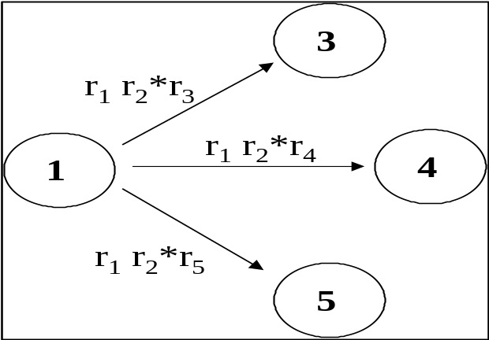
Proof of Part-II
r₁r₃
Yrd. Doç. Dr. R. Cenk Erdur, 2010

Slide 12
Proof of Part-II: Example
The T.G. given below accepts the language EVEN-EVEN. Write a R.E. for EVEN-EVEN by starting with the T.G. given below and using the procedure defined in the previous slides.
aa,bb
aa,bb
ab, ba
+
-
ab, ba
Yrd. Doç. Dr. R. Cenk Erdur, 2010

Slide 13
Proof of Part-II: Example
Step-1:
aa + bb
aa + bb
Λ
ab + ba
-
2
1
Λ
ab + ba
+
Yrd. Doç. Dr. R. Cenk Erdur, 2010

Slide 14
Proof of Part-II: Example
Step-2:
aa + bb
Λ
Λ
+
-
1
(ab+ba)(aa+bb)*(ab+ba)
Yrd. Doç. Dr. R. Cenk Erdur, 2010

Slide 15
Proof of Part-II: Example
Step-3:
(aa + bb)
+
(ab+ba)(aa+bb)*(ab+ba)
-
Λ
Λ
+
1
Yrd. Doç. Dr. R. Cenk Erdur, 2010

Slide 16
Proof of Part-II: Example
Step-4:
R.E. Corresponding to the givenT.G..
[(aa + bb)
+
(ab+ba)(aa+bb)*(ab+ba)]*
-
+
“By Pass” is applied at step-3.
Yrd. Doç. Dr. R. Cenk Erdur, 2010

Slide 17
Proof of Part-II: Question
L: Language of all words that begin and end with double letters. First, build a T.G. that accepts L. Then, reduce this T.G. to find out the corresponding R.E.
Alphabet={a,b}.
Yrd. Doç. Dr. R. Cenk Erdur, 2010

Slide 18
Proof of Part-III
The proof of this part will be by recursive definition and constructive algorithm at the same time. We will use four rules for the proof of this part. We have to find out procedures to prove each rule.
The four rules are given in the following slide…
Yrd. Doç. Dr. R. Cenk Erdur, 2010

Slide 19
Proof of Part-III
Rule-1: There is a F.A. that accepts any particular letter of the alphabet. There is a F.A. that accepts only the word Λ .
Rule-2: If the language defined by r₁is accepted by FA₁ and the language defined by r₂ is accepted by FA₂, then r₁ + r₂ is accepted by a FA_{3.}.
Rule-3: If the language defined by r₁ is accepted by FA₁ and if the language defined by r₂ is accepted by FA₂, then r₁r₂ is accepted by a FA₃ .
Rule-4: If the language defined by r₁ is accepted by FA₁ , then r₁* is accepted by a FA₂ .
Yrd. Doç. Dr. R. Cenk Erdur, 2010

Slide 20
Proof of Part-III
r₁ + r₂ corresponds to the union set of two languages L1 and L2.
r₁r₂ corresponds to the cartesian product of two languages L1 and L2.
r₁* corresponds to the closure of a language L1. Remember “Kleene Star” notation.
Yrd. Doç. Dr. R. Cenk Erdur, 2010

Slide 21
Proof of Part-III
For example, how can you build a F.A. for the R.E. (ab)*a(ab+a*)* using the rules given previously?
  If a and b are symbols in the alphabet then there are FA1 and FA2 that corresponds to them. (Rule-1)
  There is a FA3 that accepts ab. (Rule-3)
  (ab)* is accepted by a FA4 (Rule-4)
  a* is accepted by a FA5 (Rule-4)
  (ab+a*) is accepted by a FA6 (Rule-2)
  (ab+a*)* is accepted by a FA7 (Rule-4)
  a(ab+a*)* is accepted by a FA8 (Rule-3)
  (ab)*a(ab+a*)* is accepted by a FA9 (Rule-3)
Yrd. Doç. Dr. R. Cenk Erdur, 2010

Slide 22
Proof of Part-III : Rule-1
There is a F.A. that accepts only one letter or only NULL :
Only NULL
Accepts only x.
All symbols
of the alphabet
All symbols of the
alphabet except
x
+
-
x
-
+
All symbols
of the alphabet
Yrd. Doç. Dr. R. Cenk Erdur, 2010

Slide 23
Proof of Part-III : Rule-2
The procedure for the proof of this rule will be explained using the languages given below:
  FA1: The language of all words that have double a in them somewhere.
  FA2: The language of all words that have both an even number of a’s and even number of b’s.
Yrd. Doç. Dr. R. Cenk Erdur, 2010

Slide 24
Proof of Part-III : Rule-2
b
a,b
a
a
X3
+
X1
-
X2
FA1
b
b
Y1
+ -
Y2
b
a
a
a
a
FA2
b
Y3
Y4
b
FA1 + FA2 = ?
Yrd. Doç. Dr. R. Cenk Erdur, 2010

Slide 25
Proof of Part-III : Rule-2
±Z1=X1 OR Y1 (The start state of the FA that accepts the union language).
Z1 and read a : Z2=X2 OR Y3
  X1 and read a? X2
  Y1 and read a? Y3
Z1 and read b : Z3=X1 OR Y2
  X1 and read b? X1
  Y1 and read b? Y2
Yrd. Doç. Dr. R. Cenk Erdur, 2010

Slide 26
Proof of Part-III : Rule-2
Z2 and read a : +Z4=X3 OR Y1
  X2 and read a ? X3
  Y3 and read a ? Y1
Z2 and read b : Z5=X1 OR Y4
  X2 and read b? X1
  Y3 and read b? Y4
Yrd. Doç. Dr. R. Cenk Erdur, 2010

Slide 27
Proof of Part-III : Rule-2
You will go on in the same way until there remains no “Z” state that has not been examined…
  In this example, there are 12 “Z” states. You can read pages 109-113 from your textbook.
Yrd. Doç. Dr. R. Cenk Erdur, 2010

Slide 28
Proof of Part-III : Rule-3
The procedure for the proof of rule-3 will be explained on the following example:
  FA1: The language of all words that have double a in them somewhere.
  FA2: The language of all words that end in b.
Yrd. Doç. Dr. R. Cenk Erdur, 2010

Slide 29
Proof of Part-III : Rule-3
b
a,b
a
a
X3
+
X1
-
FA1
X2
b
a
b
b
Y1
-
Y2
+
FA2
a
FA1 . FA2 = ?
Yrd. Doç. Dr. R. Cenk Erdur, 2010

Slide 30
Proof of Part-III: Rule-3
Begin with FA1. You can write Z1=X1.
  Z1 and read a ? Z2=X2
  Z1 and read b ? Z1=X1
Z2 and read a ? Z3=X3 OR Y1
  X3 (Going on in FA1)
  Y1 (passed to FA2)
Z2 and read b ? Z1=X1
Yrd. Doç. Dr. R. Cenk Erdur, 2010

Slide 31
Proof of Part-III : Rule-3
Z3 and read a ? X3 OR Y1 OR Y1 = X3 OR Y1=Z3
  X3 and read a: X3 OR Y1
  Y1 and read a: Y1
Z3 and read b? +Z4=X3 OR Y1 OR Y2
  X3 and read b: X3 OR Y1
  Y1 and read b: Y2
Yrd. Doç. Dr. R. Cenk Erdur, 2010

Slide 32
Proof of Part-III : Rule-3
Z4 and read a? Z3=X3 OR Y1
  X3 and read a: X3 OR Y1
  Y1 and read a: Y1
  Y2 and read a: Y1
Z4 and read b? Z4=X3 OR Y1 OR Y2
  X3 and read b: X3 OR Y1
  Y1 and read b: Y2
  Y2 and read b: Y2
Yrd. Doç. Dr. R. Cenk Erdur, 2010

Slide 33
Proof of Part-III : Rule-3
b
a
b
a
b
Z1
-
a
Z3
Z4
+
Z2
b
a
FA1. FA2 corresponds to L1. L2.
Yrd. Doç. Dr. R. Cenk Erdur, 2010

Slide 34
Proof of Part-III : Rule-4
R.E.:
  r= a* + aa*b .
  Build a F.A. for r* . Define a procedure for building such a F.A.
Yrd. Doç. Dr. R. Cenk Erdur, 2010

Slide 35
Proof of Part-III : Rule-4
r= a* + aa*b Build a F.A.
a
a
b
X1
+ -
X2
+
X3
+
b
a,b
a,b
X4
Yrd. Doç. Dr. R. Cenk Erdur, 2010

Slide 36
Proof of Part-III : Rule-4
± Z1=X1.
  Z1 and read b: X4=Z2
  Z1 and read a: X2 OR X1=+Z3
Z2 and read a or read b; remains at Z2.
Z3 and read a : X2 OR X1=Z3
Z3 and read b : X3 OR X1 OR X4=+Z4.
Z4 and read a : X4 OR X2 OR X1=+Z5.
Z4 and read b : X4=Z2.
Z5 and read a : X4 OR X2 OR X1=+Z5
Z5 and read b : X4 OR X3 OR X1=+Z4.
Yrd. Doç. Dr. R. Cenk Erdur, 2010

Slide 37
QUESTIONS-1
+
a,b
b
+
-
a
ab
ba
Find a R.E. by reducing the T.G. given above. Use the reduction procedure
you have learned during the proof of part II of the Kleene’s theorem.
Yrd. Doç. Dr. R. Cenk Erdur, 2010

Slide 38
QUESTIONS -2
FA1: Accepts the language of all words that end with an a.
FA2: Accepts the language of all words that have an odd length.
Alphabet={a,b}
Build a finite automata FA3 that corresponds to FA1+FA2. Show all of the steps.
Yrd. Doç. Dr. R. Cenk Erdur, 2010

Slide 39
QUESTIONS -3
FA1: Accepts the language of all words that end with an a.
FA2: Accepts the language of all words that end with b.
Alphabet={a,b}
Build FA3 for FA1+FA2.
Yrd. Doç. Dr. R. Cenk Erdur, 2010

Slide 40
QUESTIONS -4
FA1: Accepts the language of all words that do not contain aa.
FA2: Accepts the language of all words that are odd in length.
Alphabet={a,b}
Build FA3 which corresponds to FA1.FA2. (Show all of the steps.)
Yrd. Doç. Dr. R. Cenk Erdur, 2010

Slide 41
QUESTIONS -5
FA1: Accepts the language of all words that contain odd number of b’s.
Alphabet={a,b}
Build the finite automata for FA1* . (Show all of the steps.)
Yrd. Doç. Dr. R. Cenk Erdur, 2010

